Slide 1

Recurrent Neural Networks
Language model and sequence generation
deeplearning.ai

Slide 2
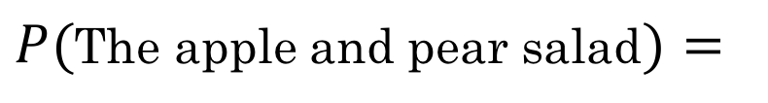
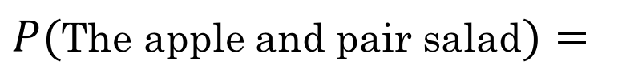
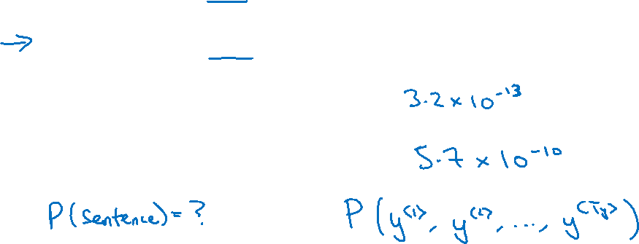
What is language modelling?
Speech recognition
The apple and pair salad.
The apple and pear salad.
$P($The apple and pair salad$)=$
$P($The apple and pear salad$)=$

Slide 3
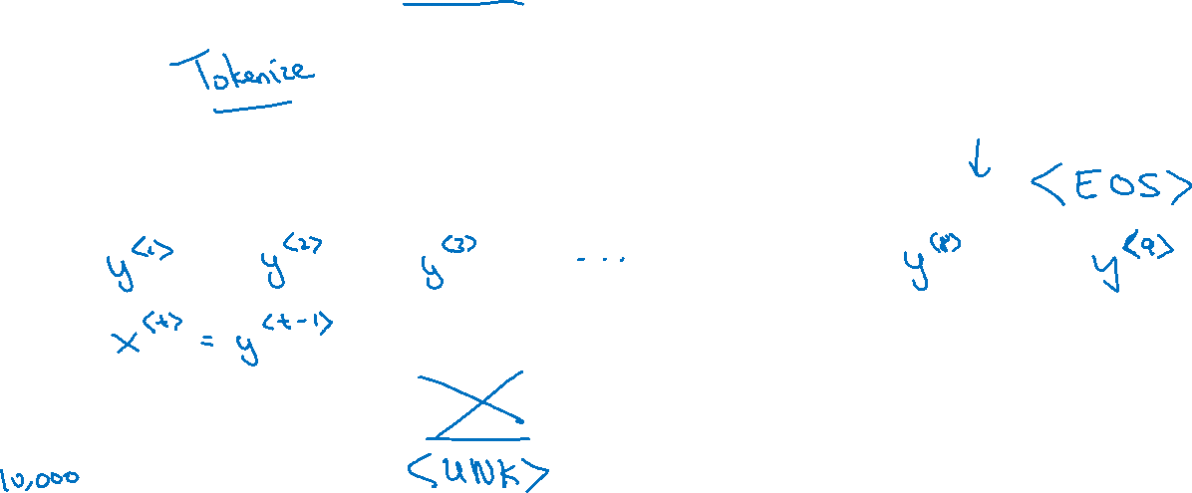
Language modelling with an RNN
Training set: large corpus of english text.
Cats average 15 hours of sleep a day.
The Egyptian Mau is a bread of cat. <EOS>

Slide 4
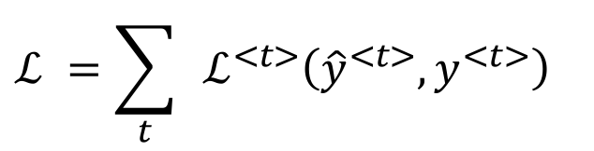
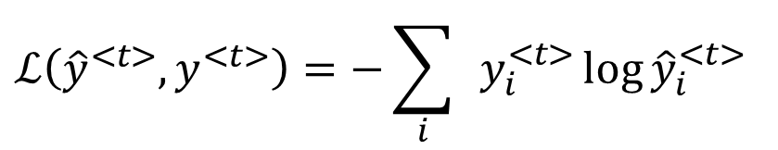
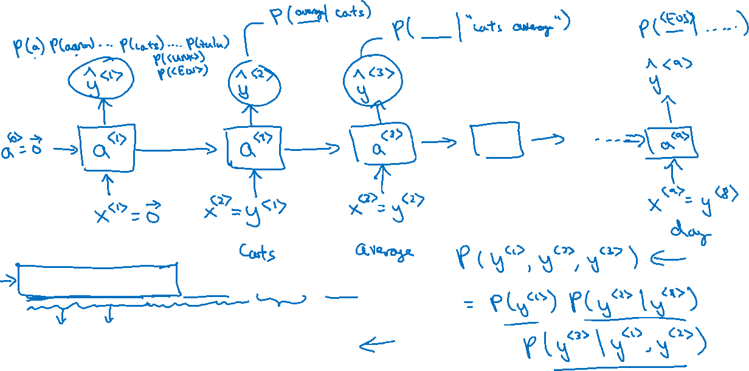
RNN model
Y-hat：长度为单词表长度的softmax，表示各单词出现的概率
Cats average 15 hours of sleep a day. <EOS>
$$ℒ\left({\hat{y}}^{<t>},y^{<t>}\right)=−\sum_{i}{ }y_{i}^{<t>}{\log{\hat{y}}}_{i}^{<t>}$$
Softmax的代价函数
$$ℒ^{ }=\sum_{t}{ }ℒ^{<t>}\left({\hat{y}}^{<t>},y^{<t>}\right)$$

